Slide 1

Gesture control game with computer vision and machine learning
Group member:
Muhammad ijaz & Muhammad jawad

Slide 2

Motivation:
Most Common Communication Tool
Hand gesture recognition for human computer interaction is an area of active research in computer vision and machine learning. One of the primary goal of gesture recognition is to create system which can identify specific gestures and use them to convey information or to control a device.
Hand posing or Hand pose being one of the most important communication tools in human's daily life, and with the continuous advances of image and video processing techniques, research on human machine interaction through gesture recognition led to the use of such technology in a very broad range of applications, like touch screens, video game consoles, virtual reality, medical applications etc.
This gesture recognition can help people with physical disability or normal people to use gesture control applications more easily.

Slide 3




Hardware Problem:
Problem
Keyboard, Mouse and Joystick is the static and traditional method to interact with computer and games, for which player need to sit in static position for long time. Which can badly effect health, especially repetitive strain injury (R.S.I) and blood circulation due to sitting on one place for long time in static position. Besides that, often typing and clicking mistakes make the reason for game over. Which is bad experience for players.
Hardware i.e, Mouse, Keyboard, Joystick etc.
Problem with Hardware use:
*Extra hardware
*Load on system due to extra hardware *keys loss functionality, stuck or hard to press
*Peoples with physical disabilities can't enjoy the game

Slide 4

Solution
We create dynamic web cam hand tracking system, with this player could control the game dynamic with body motion (gestures), which can be perform while sitting or in standing position. In this way player could enjoy the game and stay healthy as long as player wants to play the game, will get physical exercise. Besides that, dynamic physical interaction make the game more interesting and effective.
Benefits:
Long time pc use but healthy
Get enjoyment and body exercise
Make the games more interesting
Dynamic physical interaction with pc
No need of extra
hardware
less cost effective

Slide 5

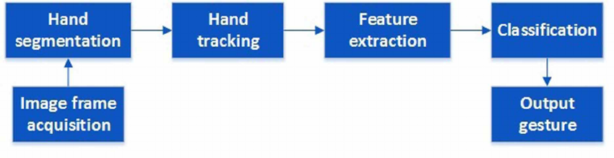
Block Diagram
Media Pipe is a cross-platform framework, which we will use for humanbody tracking.
According to above diagram, we will convert images into binary digits with the help of Numpy library. We will feed that binary image to Tenserflow trained model to extract and recognize the hand gesture and convert it into keyboards commands.

Slide 6

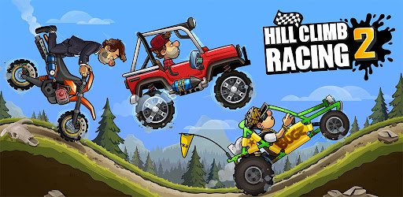
Machine learning part:
Machine Learning model will trained on a lot of games data, each game score will feed to ML model to production score for next match.
There are a lot of games are around, which can automate to hand gestures control but we select “Hill Climb Car Racing Game” because it’s available and run on any Android and OS devices and fixable with version control. There are two functionalities, to control the game, “gas” and break of a car.

Slide 7


Project deployment & deployment
Methodologies:
1. Computer vision (To detect hand)
2. Machine Learning (make predictions for upcoming matches)
3. Web development with database (For user interference & score storage) 4. Game development (Hill claim car racing game, online source)
Python libraries use: • Mediapipe: will use for Hand Tracking •
Opencv: opencv will help in image processing • TenserFlow: Tenserflow will help in understanding the hand gestures.
Web development:
Django
Django rest Api’s
Database:
Mysql databse

Slide 8
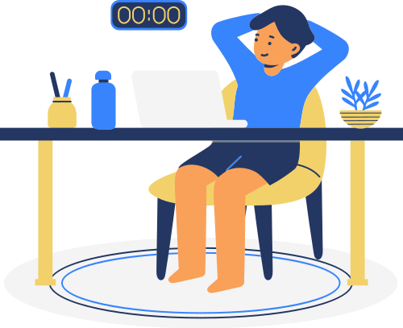
Conclusion
As an advance technology, gesture-based interaction has been applied successfully in game industry and paid more and more attention.
It provides people new experience and great pleasure which traditional interaction could not offer.
It makes the interaction between human and computer more natural.
It has been illustrated in science fiction movies that this technology can improve people’s lives if it is applied rightly.
It has a huge potential in the future if it is applied in
other fields of life.

